Slide 1
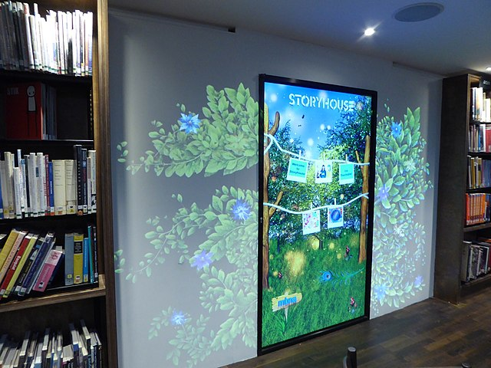
DAN OTIENO CPE 434 PROJECT: INTERACTIVE WALLS. SPRING 2023.

Slide 2

OVERVIEW
The rise of smart homes and IoT devices has created a need for innovative home solutions that integrate technology into everyday life, and offer a range of benefits, such as increased functionality, customization, and aesthetic appeal.
Digital home walls are a new concept that combines functionality and design to create a unique living experience, or a modern approach to interior design that combines digital technology with traditional wall finishes.
A digital home wall operating system would allow homeowners to seamlessly integrate and manage all aspects of their home automation systems through a centralized platform.
The system would feature an intuitive interface and powerful tools for customization, including the ability to control lighting, heating and cooling systems, entertainment systems, and more.
This operating system would be designed for installation on high-resolution display walls, providing a stunning and immersive visual experience.

Slide 3
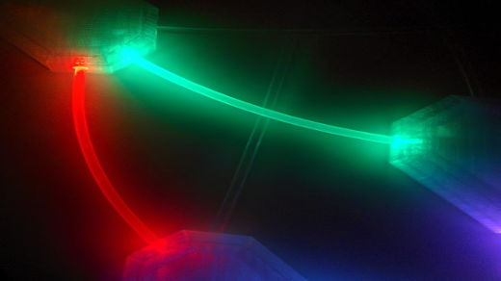
WHY DIGITAL HOME WALLS (E-WALLS)?
Customization: Digital home walls allow you to display content that is unique to your taste and style through an intuitive user interface designed for large high-resolution display walls.
Convenience: You can easily switch between different types of content, depending on your mood and preference using powerful system customization tools.
Connectivity: Digital home walls can be connected to the internet, enabling you to stream content from your favorite platforms.
Visual Appeal: Digital home walls can enhance the aesthetics of your home and serve as a conversation piece for your guests.
Compatibility with multiple voice-activated assistants such as Google Home, Amazon Alexa, and Apple HomeKit.
Enhanced security features to protect users' privacy and data.

Slide 4

SUPPORTED SYSTEMS.
Android: Android is a popular, easy to use OS that supports a wide range of apps and features. It is designed to be customizable, such that users can easily change the look and feel of their digital home walls. Additionally, Android also offers a range of security features, which ensures that your home wall is protected from potential threats.
Windows: This OS can be useful, for instance, if you want to use your digital home wall as a workstation or for gaming purposes. Windows offers a range of productivity apps and gaming tools, which can be accessed through the digital home wall, and a range of customization options, so you can tailor your home wall to suit your specific needs.
iOS: This OS would be convenient if you are already within the Apple product ecosystem. iOS offers a range of features and apps that can be accessed through your digital home wall, including Siri and FaceTime, and, like Android, secure architecture to protect your digital wall from threats.
Custom system: An exclusive OS can also be developed to manage the digital wall system architecture, including the GUI, security structure, among other functionalities. This would, perhaps, be the best course of action, as opposed to using a pre-existing architecture.

Slide 5

MORE ON CUSTOM SYSTEM…..
Designing and developing a full-sized, futuristic interactive home wall with an operating system would be a complex project that would require significant expertise in hardware and software development. Here are a few factors to consider:
GUI and Applications:
The GUI (Graphical User Interface) of the OS for the interactive home wall would need to be designed with touch input in mind, allowing users to easily interact with the wall using their hands. It would also need to be optimized for the large display screen and high resolution that the wall would require. As for applications, they would need to be tailored to the unique form factor of the wall, allowing users to access information, control smart home devices, and interact with other software in an intuitive way.
Memory:
The amount of memory required for an OS would depend on the specific features and functionality the user wants, as well as the size and resolution of the display screen. To ensure optimal performance, we would likely need a powerful processor and a large amount of RAM, as well as high-speed storage like an SSD.
Development Time and Cost:
The development time and cost for an operating system for an interactive home wall would be significant. The exact amount of time and cost would depend on the specific requirements and complexity of the project. Its also worth noting that developing an OS is a complex process that requires a team of experienced developers and engineers with access to specialized hardware and software tools.
According to some industry estimates, developing an operating system from scratch can take anywhere from several months to several years, with costs ranging from tens of thousands to millions of dollars.

Slide 6

DESIGN AND OTHER ESTIMATED COSTS.
Designing an interactive home wall with an operating system would require a significant investment in both hardware and software. The estimated cost will depend on the specific features and functionality the user wants, as well as the complexity of the installation process.
Hardware costs, for instance, would depend on the size and quality of the display screen, the processing power of the computer, and any additional sensors or components required for the interactive features. A large, high-quality display screen alone can cost several thousand dollars, while a high-end computer with the necessary processing power could cost upwards of $2,000.
Software costs would depend on the operating system and any custom software development required to create the desired functionality. If a pre-existing operating system like Windows or MacOS is used, there may be licensing fees involved. Custom software development could add significantly to the cost, with rates ranging from $75 to $200 per hour or more.
Installation costs will depend on the complexity of the project and any custom construction required to install the interactive wall, especially since we are designing a custom-built wall with integrated sensors and other features. Installation costs could be much higher.
Overall, the estimated cost of an interactive home wall with an operating system could range from $20,000 to $50,000 or more, depending on the specific features and functionality required. However, this is just a rough estimate, and actual costs would depend on a variety of factors, considering the advanced nature of the design, costs would run well over $50,000.

Slide 7

CONCLUSION
Interactive home walls would be a versatile and innovative way to enhance user experience, from examples like showcasing favorite art pieces, displaying family photos, creating an immersive home theater experience, interfacing things like lights, and other appliances within the home, or simply catching up with emails, news and other internet-related activities. A digital, full-size home wall would help achieve those goals.
The operating system required would depend on user needs and preferences. Android, Windows, and iOS are all great options, possibly even Linux and modified versions of current smart TV systems, each with their unique features and benefits. A dedicated OS can also be developed specifically for an interactive home wall, but ultimately, the right OS will ensure that the digital home wall is efficient, effective, and secure.
While operating systems in digital home walls have the potential to revolutionize the way we interact with our homes, but the costs associated with implementing such a system are significant, and it is important to carefully evaluate the potential benefits and drawbacks before proceeding with such an undertaking. A lot of time and effort would need to be dedicated to delicate components such as memory and security, and how those would be implemented in a way that avoids risks of compromised user data.

Slide 8

WORKS CITED.
Cho, S. (2021). Future Home: A New Era of Smart Living. Springer.
Spilka, R., & Tsai, J. Y. (2019). Handbook of Human-Computer Interaction. Springer.
"How Much Does Custom Software Development Cost?" by Redwerk, https://redwerk.com/blog/how-much-does-custom-software-development-cost/
"How Much Does a Video Wall Cost?" by Datapath, https://www.datapath.co.uk/news/how-much-does-a-video-wall-cost
"How Long Does It Take to Build an Operating System?" by CodeCondo, https://codecondo.com/how-long-does-it-take-to-build-an-operating-system/
"How Much Does It Cost to Develop Custom Software?" by ScienceSoft, https://www.scnsoft.com/blog/how-much-does-it-cost-to-develop-custom-software
"How to Develop an Operating System from Scratch?" by Cleveroad, https://www.cleveroad.com/blog/how-to-develop-an-operating-system-from-scratch
https://prodisplay.com/touch-screens/interactive-screens/interactive-video-wall/#:~:text=WHAT%20IS%20AN%20INTERACTIVE%20VIDEO,touch%20frame%20to%20grant%20interactivity
https://medium.com/mouth-watering-media/the-top-10-digital-interactive-display-walls-40b96066477c
Heidrich, Felix, et al. "Interacting with smart walls: a multi-dimensional analysis of input technologies for augmented environments." Proceedings of the 2nd Augmented Human International Conference. 2011. (https://hci.rwth-aachen.de/publications/heidrich2011a.pdf)
https://www.bareconductive.com/blogs/blog/our-favorite-interactive-wall-projects

